Slide 1

Geospatial analysis of Avian activity in the RGV on Python with eBird.api and GIS.api
Bridgett Collis
Scientific Computing

Slide 2
A little Bit on the RGV
The avifauna in deep South Texas is the most diverse north of the Mexican border
It is a major bird migration corridor; the convergence of two major flyways (the Central and Mississippi)

Slide 3
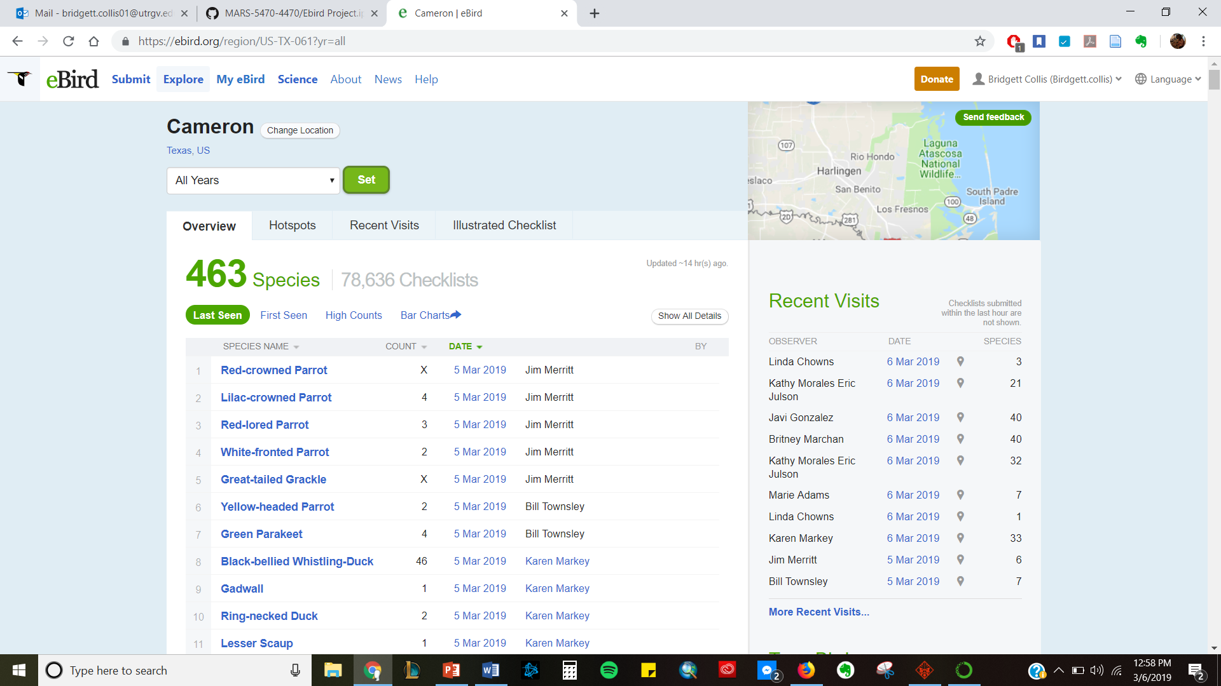

Slide 4
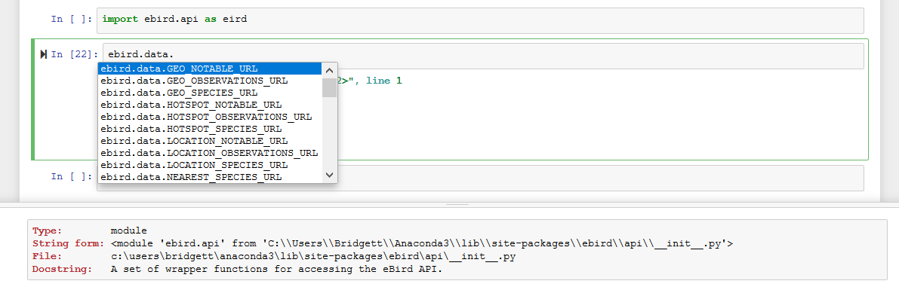
First steps – Access the API

Slide 5
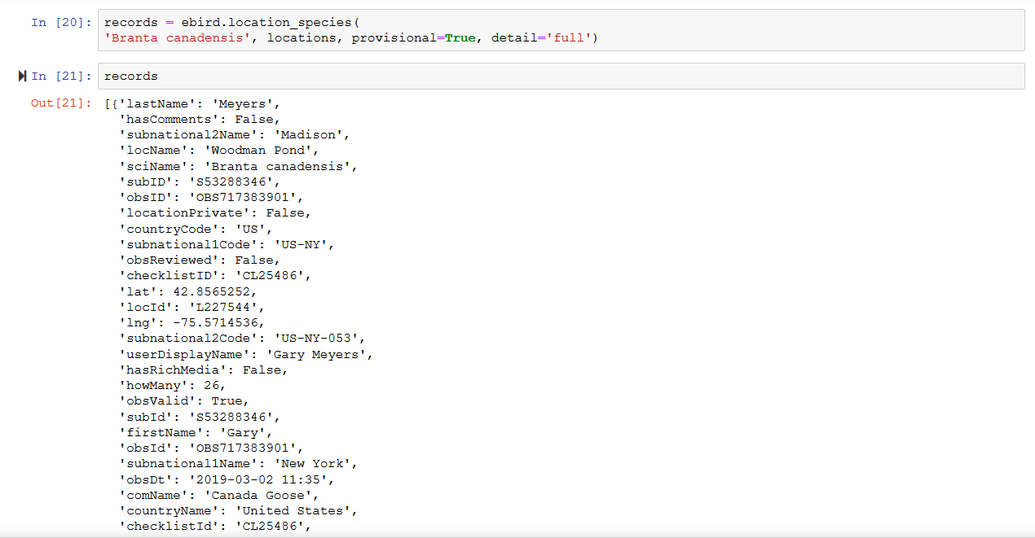
Step 2 – Accessing Info by species

Slide 6
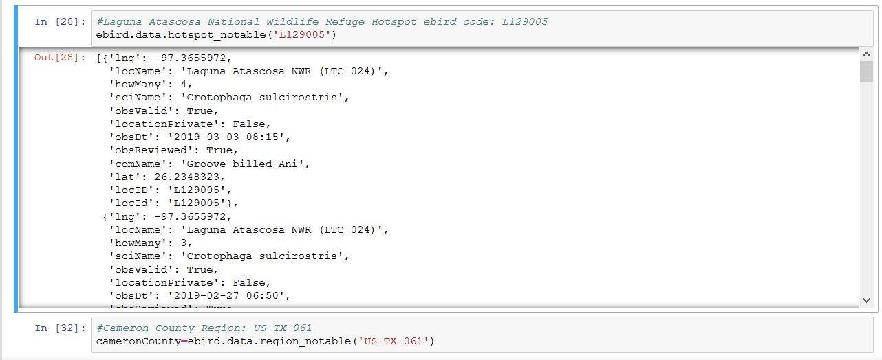
Info by Hotspot or by County

Slide 7
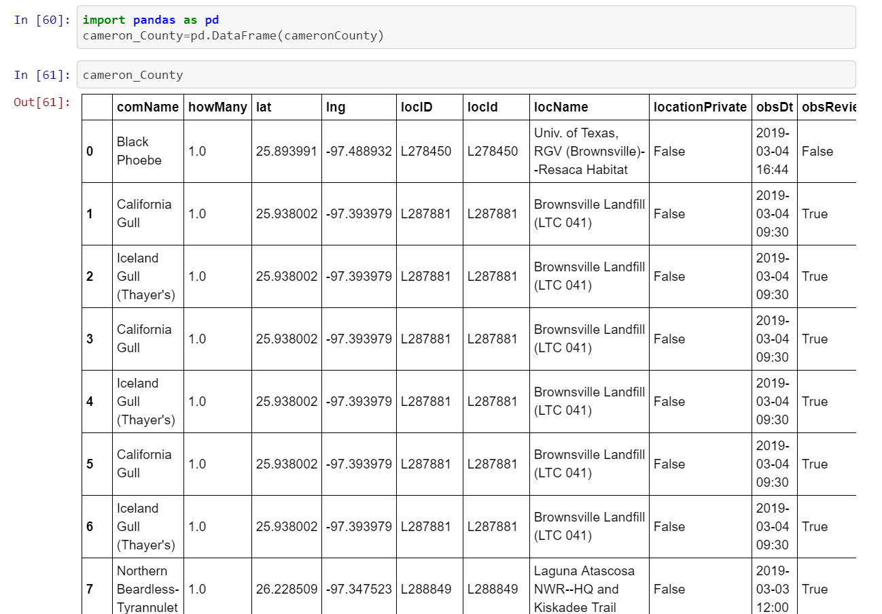
Data Prep

Slide 8
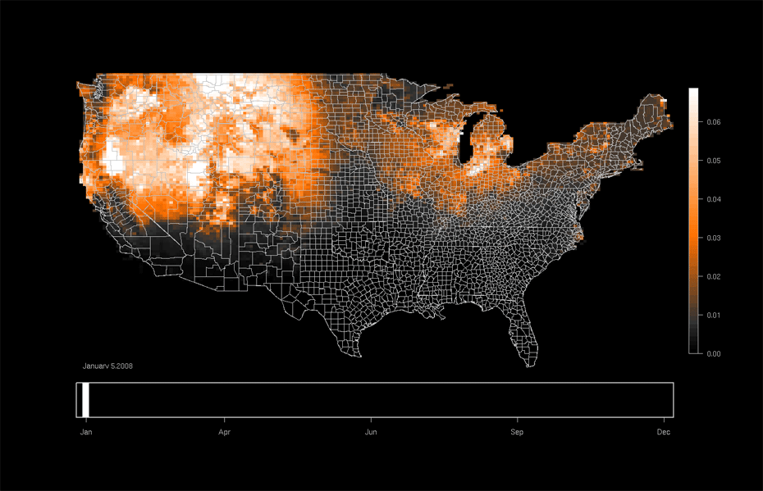
Goal: establish the significance of the RGV in Avian Ecology

